Slide 1



2 Corinthians Ch 13
Aug 25, 2024
Module 5, Room 1

Slide 2
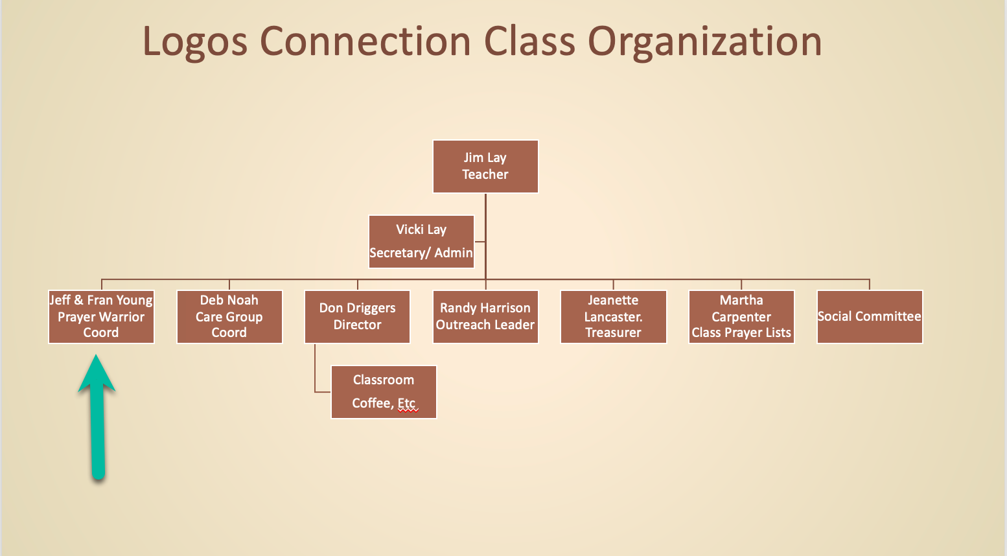

Slide 3
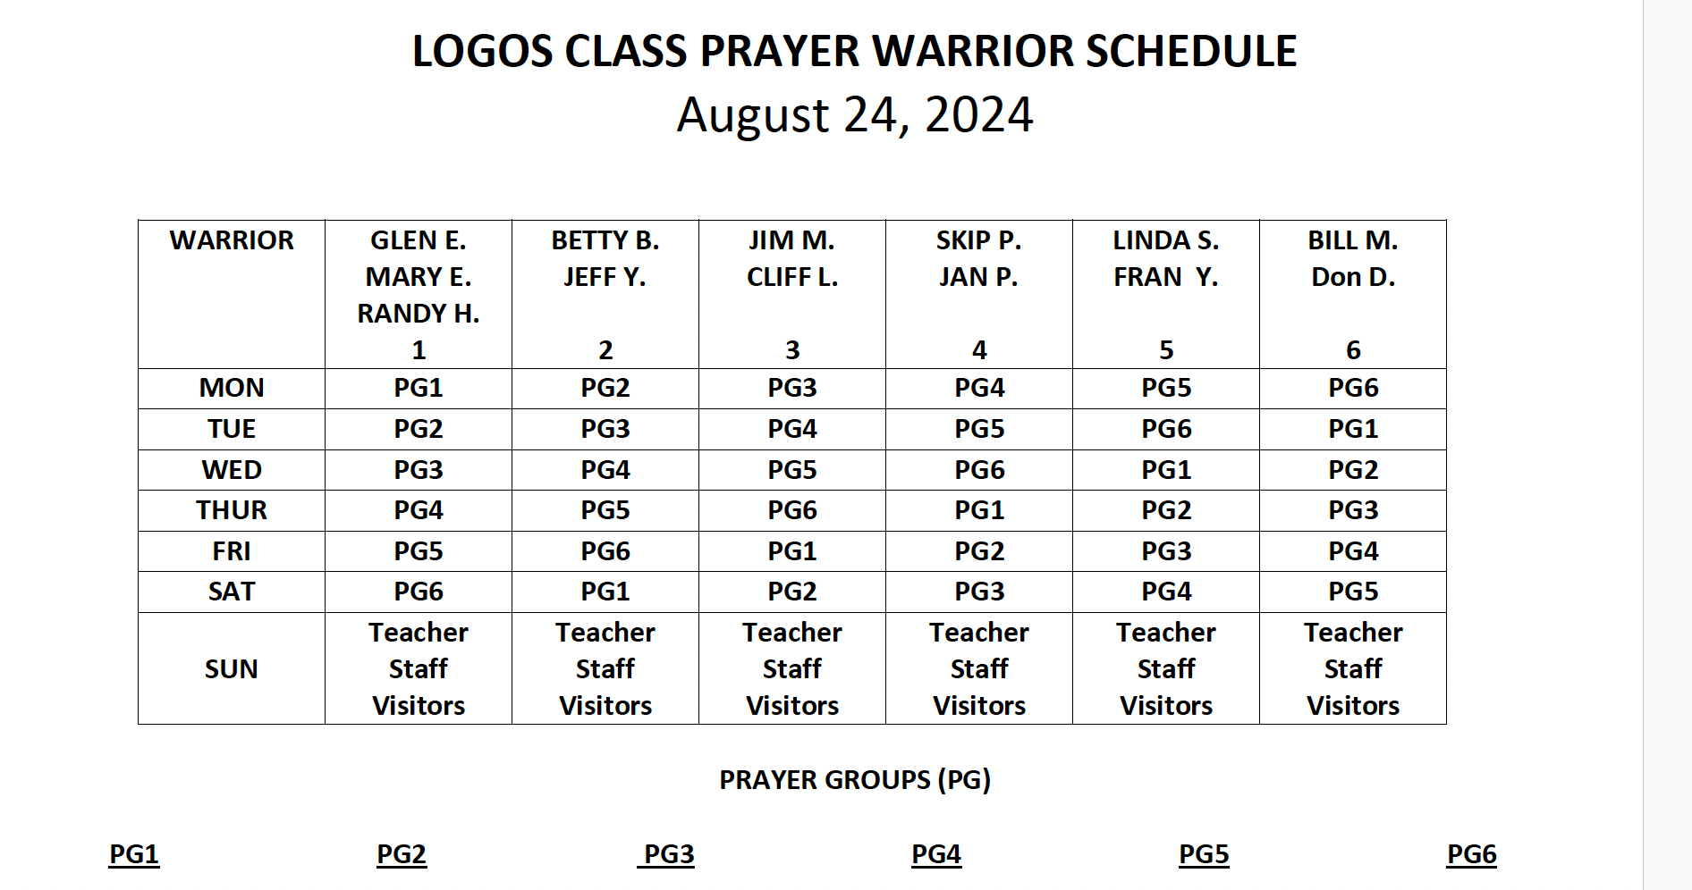

Slide 4
Class Schedule for the next few weeks
July 14, 2024 – 2 Cor Ch 7
July 21, 2024 - 2 Cor Ch 8
July 28, 2024 - 2 Cor Ch 9
Aug 4, 2024 - 2 Cor Ch 10
Aug 11, 2024 - 2 Cor Ch 11
Aug 18, 2024 - 2 Cor Ch 12
Aug 25, 2024 - 2 Cor Ch 13 & wrap
Sept 1, 2024 - New Study
Notes:
Lay Class
Modular 1:1
8/23, 9/6, 9/20
9:30 Each Sunday

Slide 5
Quick Update ...ICYMI
Middle East
Hostage Negotiations and Cease Fire Negotiations are dead. Hamas has rejected them and placed a new demand that Sinwar be guaranteed not to be assassinated by Israel
Israel continues to destroy terrorists in Gaza, Lebanon, and Israel (West Bank)
Hezbollah continues relentless attack on Northern Israel – Fires and evacuations
Israel has target packages against Iran complete and ready. Abraham Lincoln carrier group has arrived in the Mediterranean area
Israel and the US continue moving forces in anticipation. Prayerfully they are prepared with God’s intervention and plan. Iran has blinked
Uneasy time with Russia, Turkey, Iran, Syria, and Iraq all facing Israel and preparation anxiety
US/World
Ukraine has entered multiple areas of Russia and destroyed resupply bridges and depots.
Advanced weapons are being used by Ukraine, Russia attacking Ukraine's Nuclear Plants
Earthquakes in Russia, Lebanon/Syria, and Iran. A reminder of who is really in control??
DNC in Chicago over with large opposition, mostly un-reported by MSM
Hold Fast to the Faith and Keep moving forward in God’s path. God Has This...

Slide 6
Overall Outline of 2nd Corinthians
The Comfort of God Ch 1-7
Introduction – Ch 1:1,2
Comfort for Life’s Plans - Ch 1:3-24
Comfort in the restoration of sinning saint – Ch 2
Comfort in the glorious ministry of Christ – Ch 3
Comfort in the ministry of suffering for Christ – Ch 4
Comfort in the ministry of martyrdom for Christ – Ch 5
Comfort in all circumstances – Ch 6
Comfort in the Heart of Paul – Ch 7
Christian Giving – Ch 8-9
Examples, Exhortation, Explanation, and Encouragement
The Calling of the Apostle Paul – Ch 10-13
Spiritual War, Man of God – Ch 10
Loyalty and Apostleship– Ch11
Apostles, Pastors, Uniqueness – Ch 12
Pattern of Sanctification – Ch 13:1-10
Benediction – Ch 13:11-14

Slide 7
2 Cor Ch 12 Chapter 12 Key Points
Paul speaks of both a vision and a torment
Tells us about his vision and being taken to the 3rd Heaven, which is where God lives
Does not tell us what he sees but tells us that what he saw was both inexpressible by him, and that he is not allowed to talk about it
Paul tells us of the authentication signs of a True Apostle
Signs, Wonders, and Miracles
He did all of them
We talked about modern-day Apostles, Visits to Heaven, etc., and how to think about what they say and do
Paul talked about his “thorn in the flesh” which was not taken away by the Lord to keep Paul humble and that God’s grace was sufficient for him to deal with it
Paul used both humor and Holy Sarcasm to make light of the accusations by some of the Corinthians

Slide 8
Before we get into Chapter 13
I want to take us back to Ch 12:20-21
²⁰ For I am afraid that when I come, I may not find you as I want you to be, and you may not find me as you want me to be. I fear that there may be discord, jealousy, fits of rage, selfish ambition, slander, gossip, arrogance, and disorder.
²¹ I am afraid that when I come again my God will humble me before you, and I will be grieved over many who have sinned earlier and have not repented of the impurity, sexual sin, and debauchery in which they have indulged.

Slide 9
2 Cor Ch 13 Background leading up to Ch 13
Pastor John MacArthur has many sermons on just the first 2 verses of this chapter. It is worthwhile to find his sermons and listen to them.
The background is important, and reading 1 Corinthians will set that for you.
1 Cor Ch 5:1-5 Dealing with a case of incest in the church
5 It is actually reported that there is sexual immorality among you, and of a kind that even pagans do not tolerate: A man is sleeping with his father’s wife.
² And you are proud! Shouldn’t you rather have gone into mourning and have put out of your fellowship the man who has been doing this?
³ For my part, even though I am not physically present, I am with you in spirit. As one who is present with you in this way, I have already passed judgment in the name of our Lord Jesus on the one who has been doing this.
⁴ So when you are assembled and I am with you in spirit, and the power of our Lord Jesus is present,
⁵ hand this man over to Satan for the destruction of the flesh, so that his spirit may be saved on the day of the Lord.

Slide 10
In the last part of Ch 12
Paul lays out what he fears seeing (again) In Corinth
The sins of discord, jealousy, fits of rage, selfish ambition, slander, gossip, arrogance, and disorder.
And no repentance of the sins of impurity, sexual sin, and debauchery in which they have indulged.
Paul has warned them over and over in the letters to the Corinthians to get themselves straightened out and he does it again here, for a final time

Slide 11
2 Cor Ch 13:1-4 Final Warnings...
13 This will be my third visit to you. “Every matter must be established by the testimony of two or three witnesses.” [Deut. 19:15]
² I already gave you a warning when I was with you the second time. I now repeat it while absent: On my return, I will not spare those who sinned earlier or any of the others,
³ since you are demanding proof that Christ is speaking through me. He is not weak in dealing with you but is powerful among you.
⁴ For to be sure, he was crucified in weakness, yet he lives by God’s power. Likewise, we are weak in him, yet by God’s power we will live with him in our dealing with you.

Slide 12
2 Cor Ch 13:5-6 Examining ourselves
⁵ Examine yourselves to see whether you are in the faith; test yourselves. Do you not realize that Christ Jesus is in you—unless, of course, you fail the test?
⁶ And, I trust that you will discover that we have not failed the test.

Slide 13
2 Cor Ch 13:7-10 Weakness / Strength / Restoration
⁷ Now we pray to God that you will not do anything wrong—not so that people will see that we have stood the test but so that you will do what is right even though we may seem to have failed. (soul competency)
⁸ For we cannot do anything against the truth, but only for the truth.
⁹ We are glad whenever we are weak, but you are strong; and our prayer is that you may be fully restored.
¹⁰ This is why I write these things when I am absent, that when I come, I may not have to be harsh in my use of authority—the authority the Lord gave me for building you up, not for tearing you down.

Slide 14
2 Cor Ch 13:11- 14 Benediction
¹¹ Finally, brothers and sisters, rejoice! Strive for full restoration, encourage one another, be of one mind, live in peace. And the God of love and peace will be with you.
¹² Greet one another with a holy kiss.
¹³ All God’s people here send their greetings.
¹⁴ May the grace of the Lord Jesus Christ, and the love of God, and the fellowship of the Holy Spirit be with you all.

Slide 15
Final Instructions from Paul
What a final closing thought for them. After preparing them for his return, he closes with a benediction that is timely for us as well.
Rejoice! (in all things rejoice...in suffering, in trouble, in glory, in mountain tops, in the valley of decision
Strive for full restoration – confess your sin, repent, ask for forgiveness, and walk away from the activity you have repented from
Encourage one another – For us, we try to do that with each other in this class, but also a wider audience for us is other Christians.
Be of one mind – Walk in the Spirit together in unity with each other and with God. We are not all the same, but we can be unified in the Spirit.
Live in peace – Do not cause strife, anger, provoke others...as far as you can, live in peace with one another. One of the best ways we can reduce our anger toward our enemies is to pray for them.
AND THE GOD OF ALL PEACE AND LOVE will be with you

Slide 16
2 Corinthians – An Assessment
After all the problems, after all the corrections, and after all the heartache, we end this book with peace.
It is a fitting way to remember Paul as...
Humble yet forceful,
Forgiving yet accountable
weak yet powerful,
Servant yet Apostle,
As one with Love and Hope for the Corinthians.

Slide 17
Next Week
I will send a note this week about what we will study next
Pray for God to move in the US, protect Israel, and the leaders
Pray for First Redeemer Pastors, staff, teachers, and all who lead
Pray for your family and friends inside and outside the church. Pray for healing for those in grief and recovery
Be thankful that God has placed you in this day and time and commit your will ...to doing His Will.
Praise Him for the blessings He continually bestows on us.
Pray for each of us to take our role seriously in the coming storm
Pray for those who don’t know the Lord to come to Him

